Slide 1

AMAZON PRODUCT RATING ANALYSIS

Slide 2

PROJECT OBJECTIVES:
Problem definition
Data collection
Data processing
Exploratory Data Analysis (EDA)
Visualization using dashboards in Tableu
Conclusion

Slide 3
1.Problem definition:
Find the sales in amazon product
Determine profit and loss
Rating and reviews of the products

Slide 4
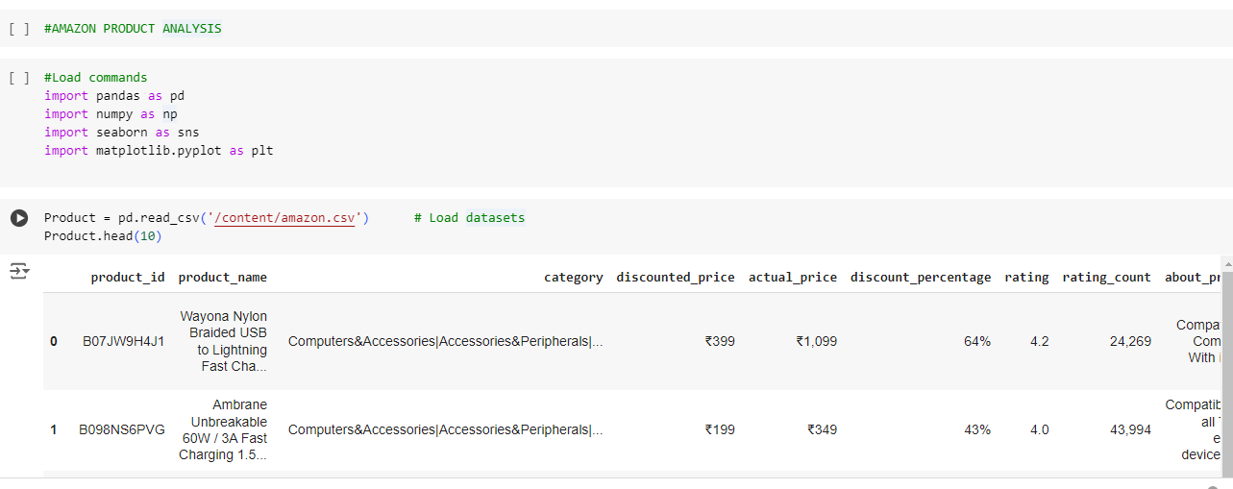
2. Data Collection:

Slide 5
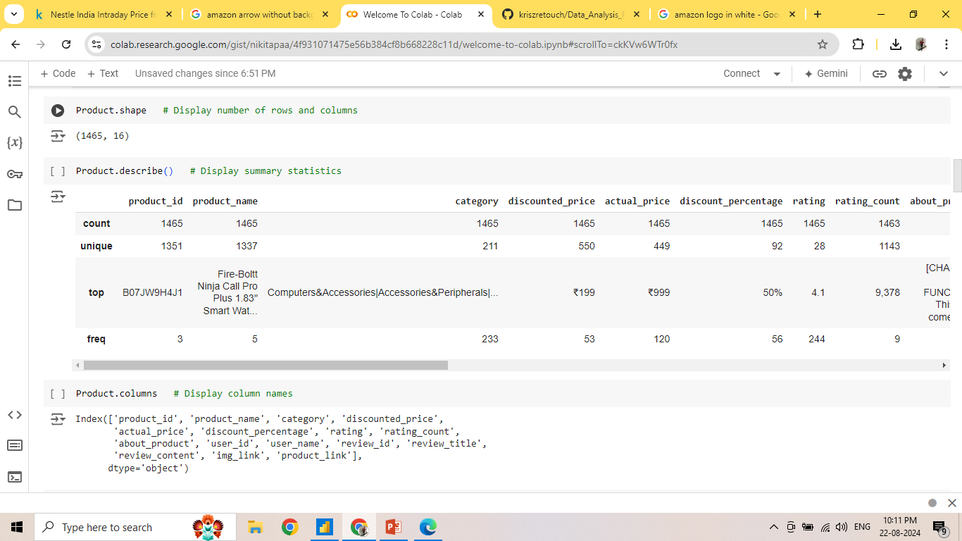
3. Data Processing:
Display no. of rows and columns
Summary Statistics

Slide 6
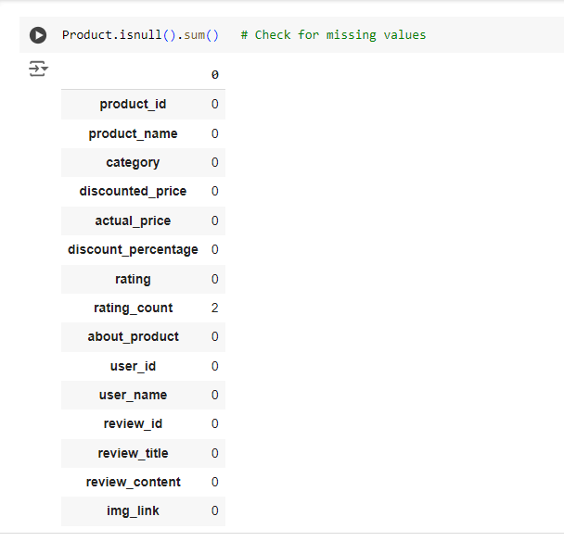
Names of columns
Checking for NULL values

Slide 7
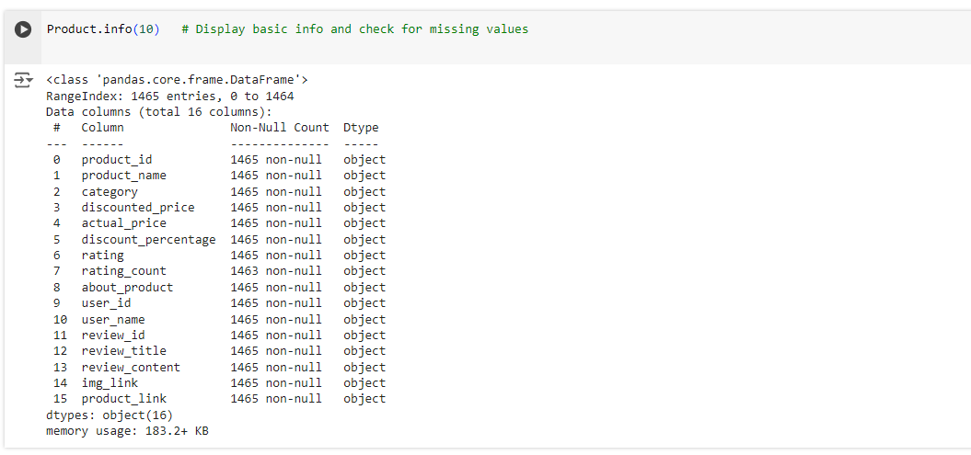
Checking for Missing values

Slide 8
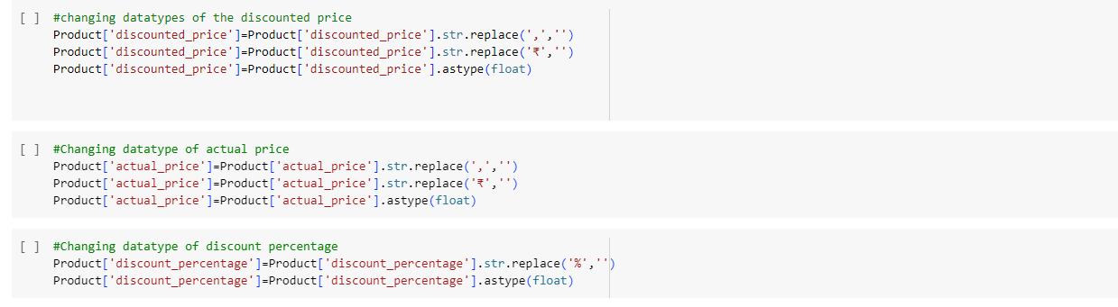
Changing the datatypes of discount , actual price and discount percentage columns.

Slide 9
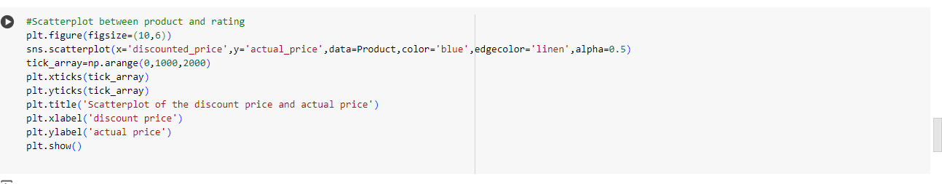
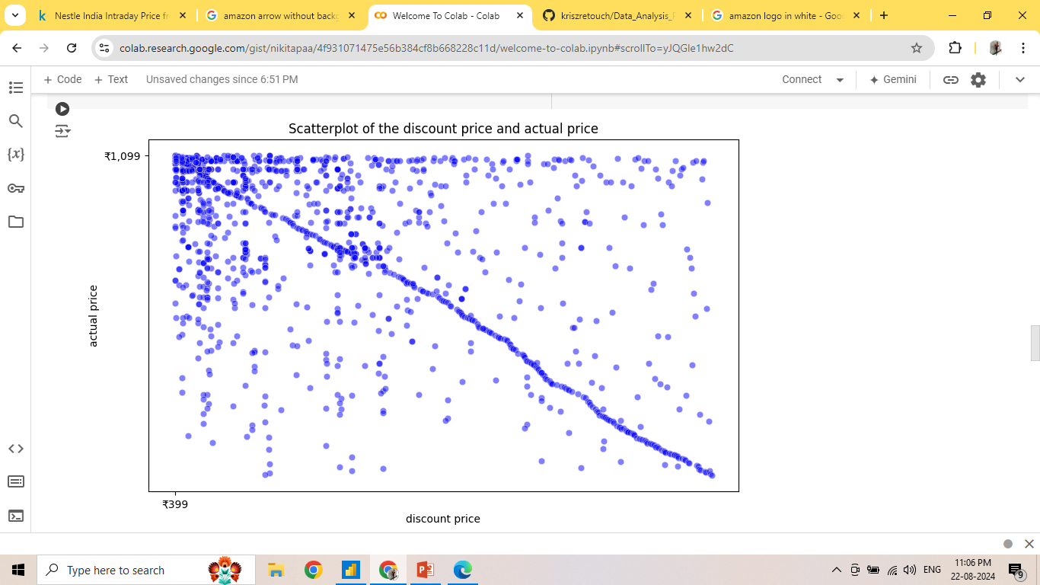
Data Visualization: Scatterplot between product and rating

Slide 10
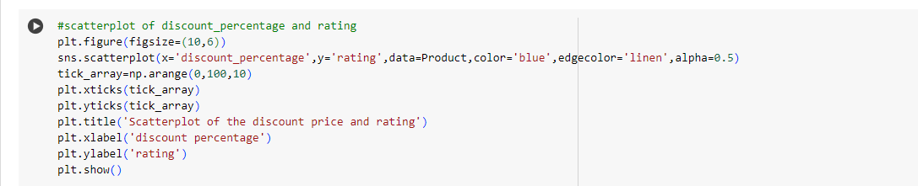
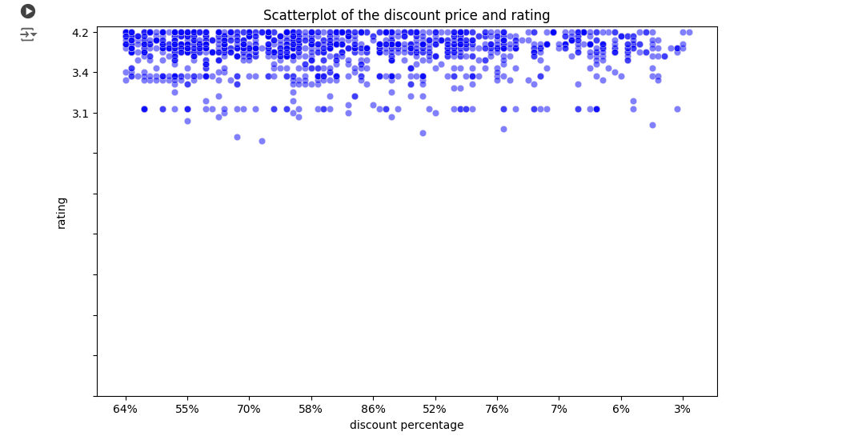
Scatterplot between discount percentage and rating

Slide 11
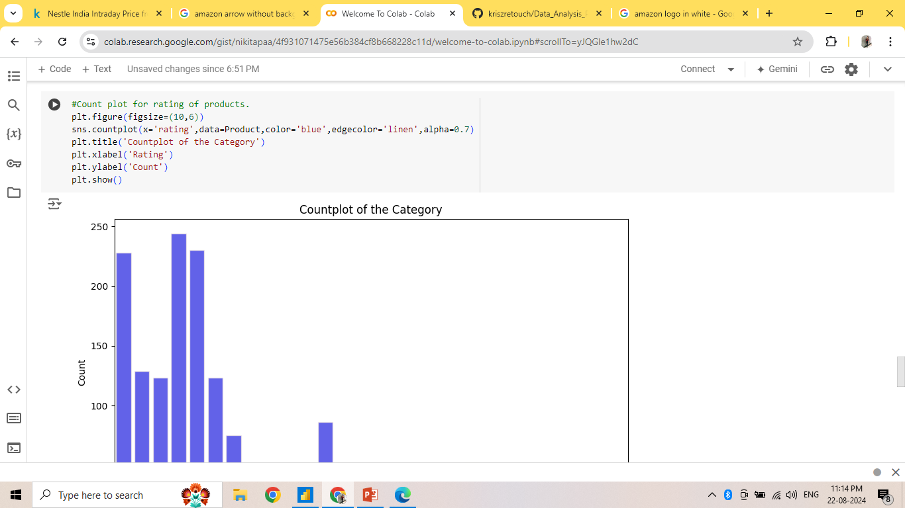
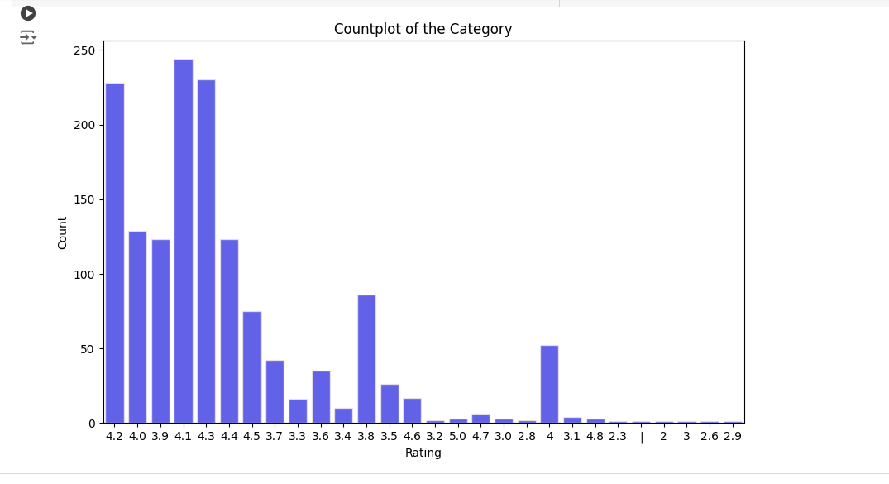
Countplot of rating:

Slide 12
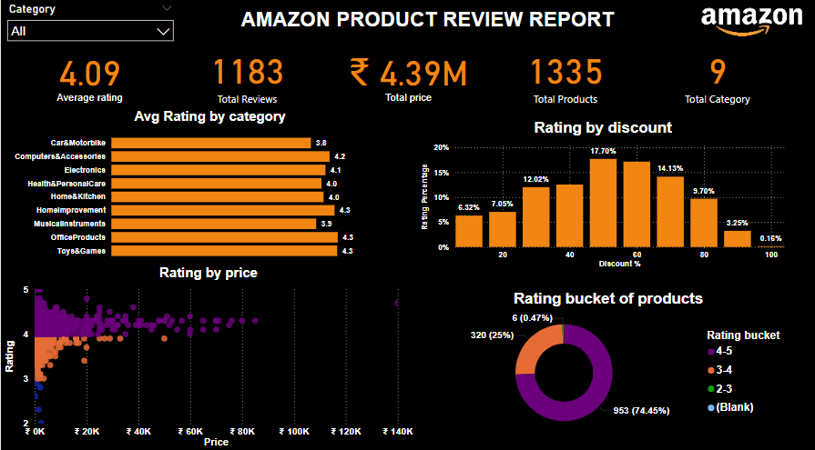
DASHBOARD using Power BI:

Slide 13
ANALYSIS:
Key Metrics Displayed
Average Rating:
4.09 stars.This represents the average rating across all products.
Total Reviews:
1,183 total reviews have been collected.
Total Price:
₹4.39M represents the cumulative price of all the products listed.
Total Products:
1,335 products are included in this analysis.
Total Categories:
9 different product categories are analyzed

Slide 14
Insights and Observations
High Ratings Correlation: Categories like "Musical Instruments" and "Home & Kitchen" have higher average ratings, which could indicate better product quality or customer satisfaction in these categories.
Discount Impact: Products with a 60% discount seem to attract more reviews, possibly indicating that customers are more likely to buy and review heavily discounted items.
Price vs. Rating Distribution: Most products priced under ₹60K show a wide range of ratings, suggesting that there’s no direct correlation between price and customer satisfaction in these ranges.
Predominance of High Ratings: A significant portion of products (74.45%) are rated between 4 to 5 stars, which might suggest that customers are generally satisfied with their purchases or that the product listing features higher-rated items.

Slide 15
CONCLUSION:
This Power BI dashboard offers a clear and comprehensive overview of product performance on Amazon, leveraging key metrics such as average ratings, total reviews, and product prices. The analysis indicates that certain categories like "Musical Instruments" and "Home & Kitchen" have higher customer satisfaction, while the distribution of ratings across various price points and discount levels suggests complex consumer behavior patterns. The predominance of high ratings (4-5 stars) across most products reflects overall positive customer feedback. However, the data also highlights opportunities for targeted marketing strategies, particularly around discounting practices that effectively drive customer engagement. Future iterations of this dashboard could benefit from enhanced interactivity and deeper analysis of customer feedback trends to provide more granular insights into product performance and customer preferences.

